Slide 1
Python-Hacker’s Paradise
Python is a programming language that lets you work quickly and integrate systems more effectively.

Slide 2
What is Python
It is an open source language. Its code is very simple so its very easy to learn for a beginner as well. It was developed by Guido von Rossum.
Python can be used for small or big projects and these projects can be online and offline.
Python is a high level programming language that enjoys extensive popularity among developers and programmers. Python code is not only easy to read but also looks good.
As a object oriented programming language, Code reusability is an important feature of this language. Its syntax allows concepts to be expressed in fewer lines of code.

Slide 3
Applications of Python
Desktop Applications (Tkinter)
Web Applications (django)
Web Scraping
Data Science
Robotics & Artificial Intelligence
Astro – Physics (Numpy and Scripy)
Machine Learning

Slide 4
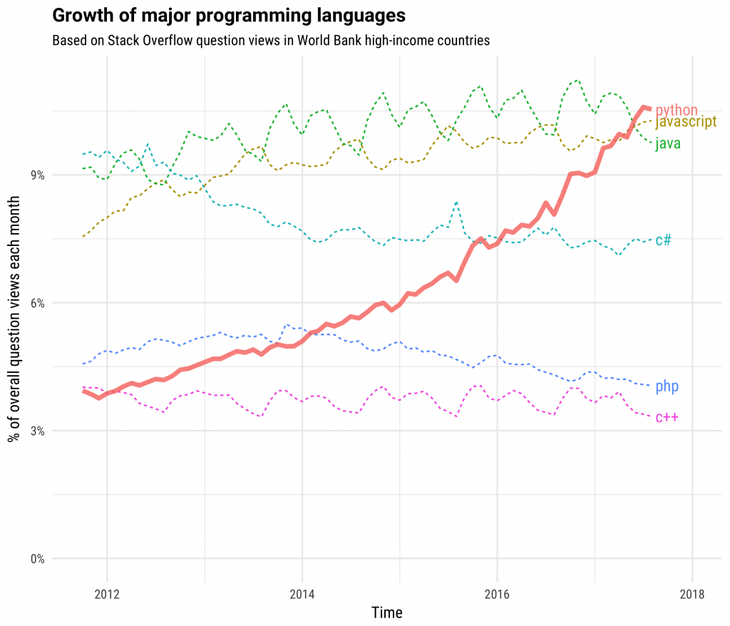
Title and Content Layout with Chart
Courtesy By - stackoverflow

Slide 5
Two Content Layout with Table
First bullet point here
Second bullet point here
Third bullet point here
Class | Group A | Group B
Class 1 | 82 | 95
Class 2 | 76 | 88
Class 3 | 84 | 90

Slide 6
Two Content Layout with SmartArt
Group A
Task 1
Task 2
Group B
Task 1
Task 2
Group C
Task 1
First bullet point here
Second bullet point here
Third bullet point here

Slide 7
Add a Slide Title - 1

Slide 8
Add a Slide Title - 2

Slide 9
Add a Slide Title - 3

Slide 11
Add a Slide Title - 4

Slide 12
Add a Slide Title - 5

